Slide 1
Winter Term Presentation
By
Charlie
Hatch

Slide 2
Core
The fact that Independence includes basically any skill that you use
While I knew a good amount of the secific ones, it did do 2 things:
Fill in/ add a few details
Show me that what I knew was accurate, unlike what others have told me
Notes:
Use words

Slide 3
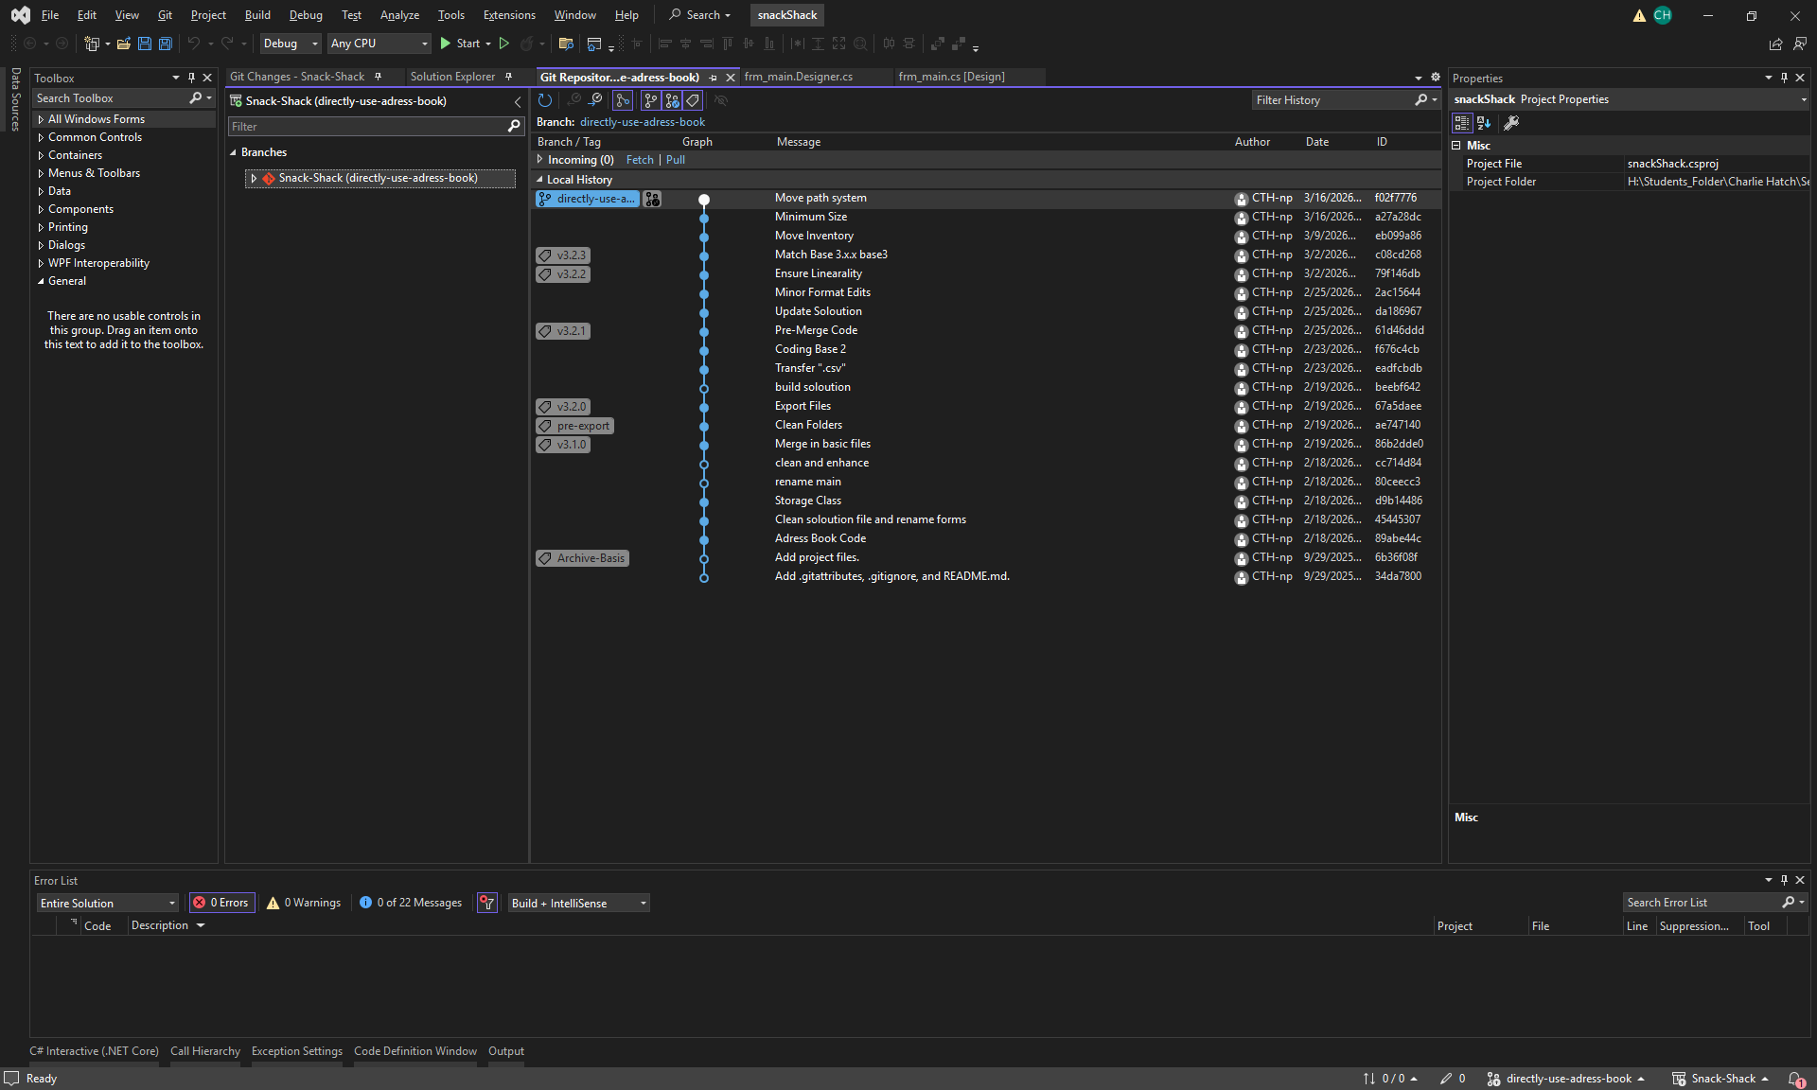
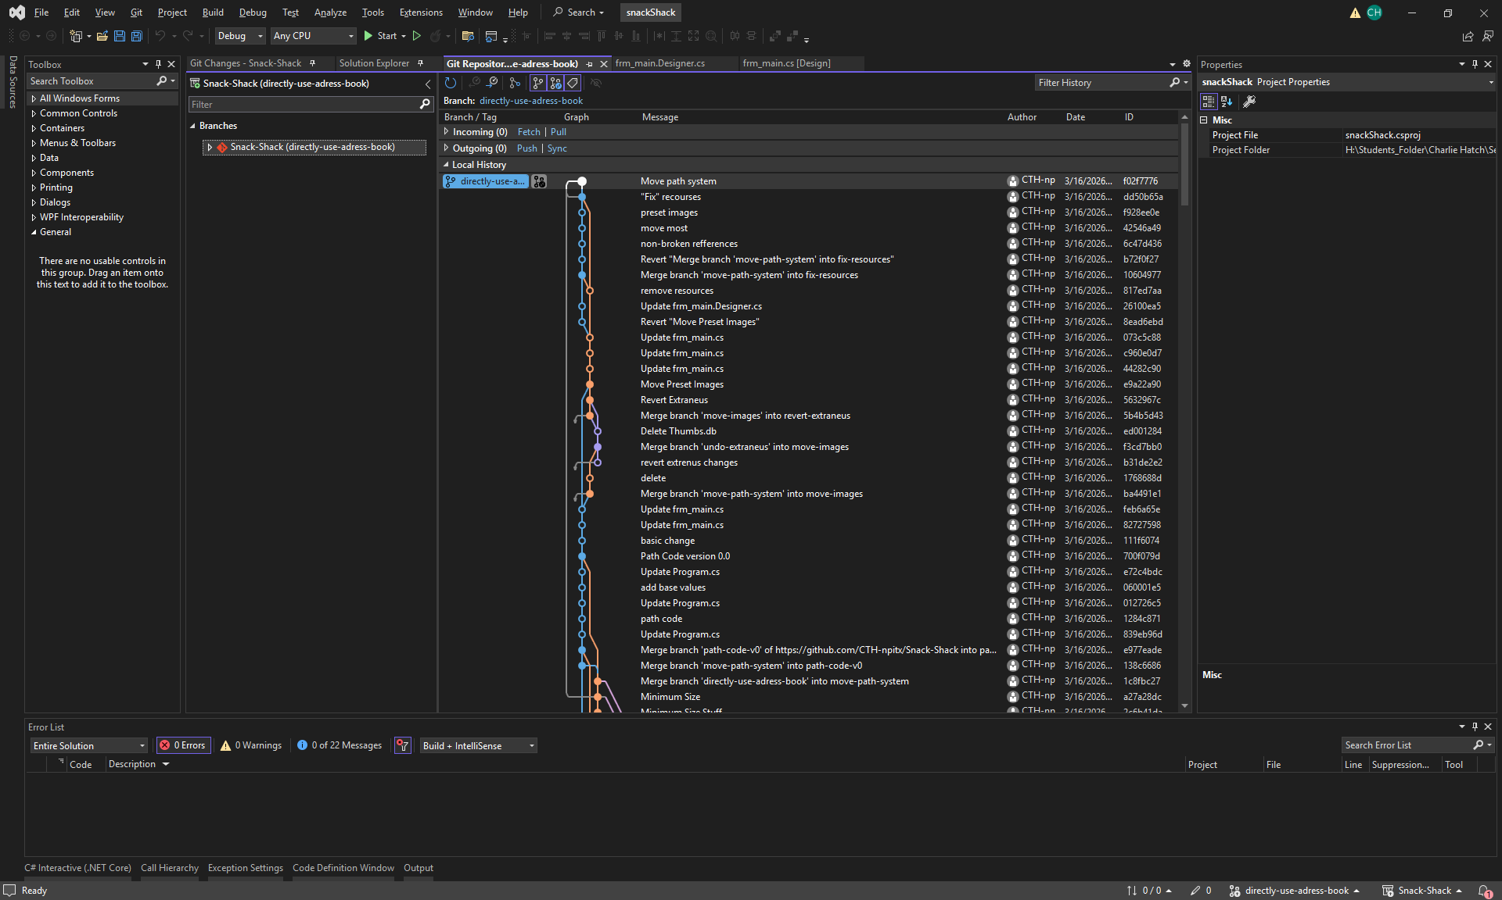
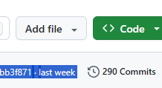

Appdev 3/ IT
In appdev 3 I continued work on my “snack shack”, this time trying to re-write it with the concepts from another code (my address book).
The hardest part was, well, the same as the easiest part, getting the code to function. It would make sense and work (easiest), then… not (hardest)
As for what I managed, well, I somewhat re-built it, and was able to re-use code, so the same amount of work was done in:
290 commits
As opposed to
902 commits
As for IT, I did lots of stuff, but the one which sticks out is breaking windows by deleting system32
As well as doing a similar thing to linux

Slide 4
Favorite Memory
Well, it’s hard to choose. So, I’ll go deleting part of system32 and breaking a windows install.
As well as breaking linux via something similar

